Slide 1
Adverse Events reported to the FDA
Project Vita-Mine
Pam, Neal, Dinesh, and Ying

Slide 2

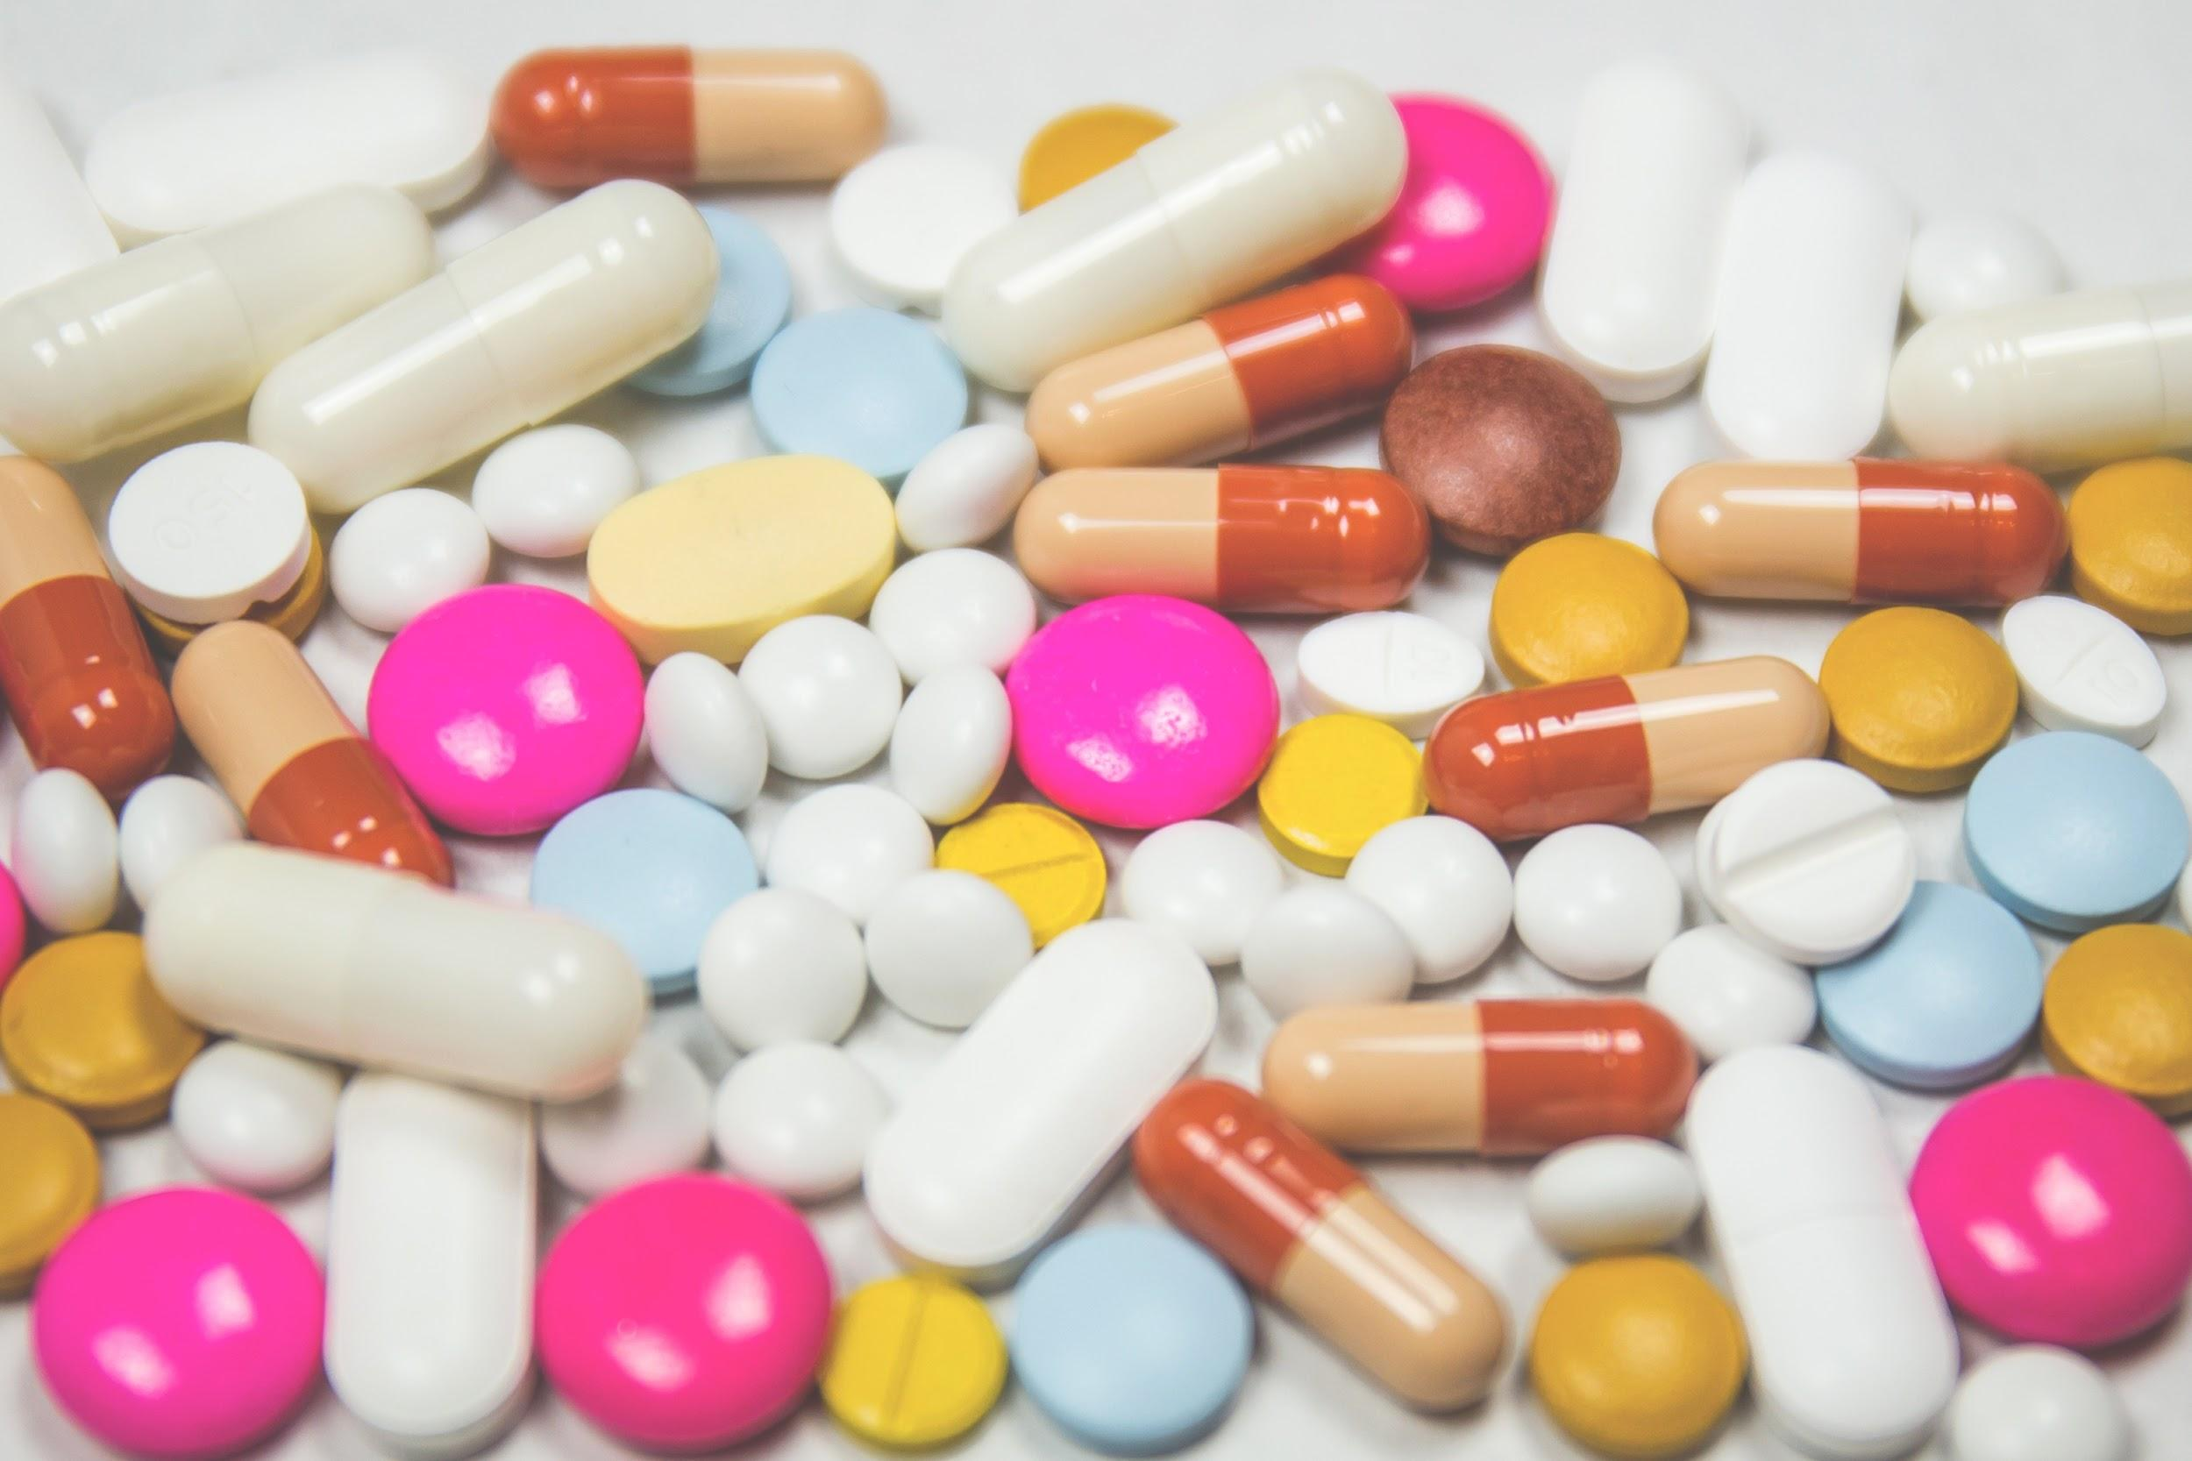
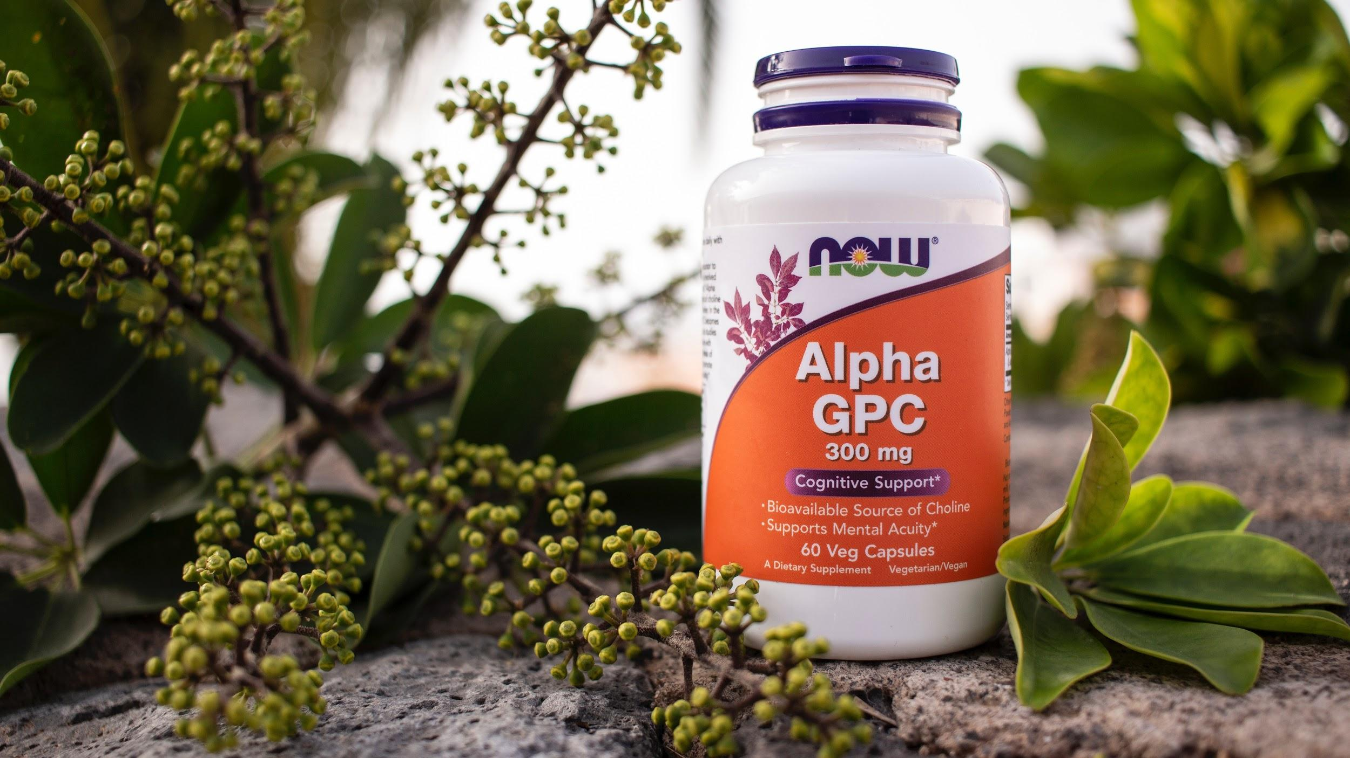
Drugs
Dietary Supplements
Must be proven safe and effective
Strictly regulated
Prescription required
Safe, until proven unsafe
cGMP regulated but no clinical trials
Self-prescribed

Slide 3
Who We Are
Our mission as data scientists at Vita-Mine to evaluate the safety of foods, dietary supplements, and cosmetics based on adverse event reports submitted to the FDA.
Data Source: https://www.kaggle.com/fda/adverse-food-events ~90K reported incidents (2004- mid 2017)

Slide 4
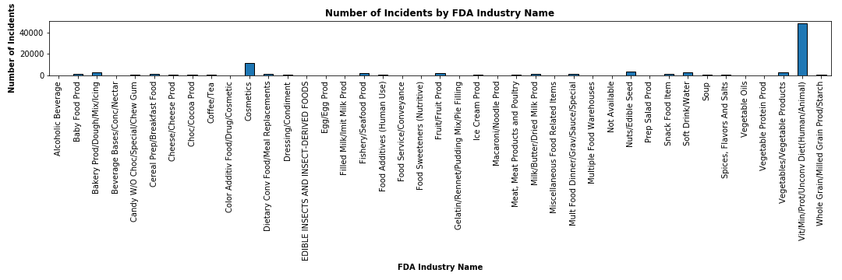
Total incidents: ~90K
~35K

Slide 5
Data Collection
Data Cleaning
Analysis
CSV file (~90K rows, 12 columns)
Initial proposal - food allergy (~5K)
Revised proposal - vitamins (~35K)
Dropped rows with NaN and data for 2017
Created functions to combine repetitive categories of vitamins
Parsed data to show final outcome, brand/product name, gender, age (years), adverse reaction date
Assigned severity level (1 to 6) depending on final outcome
Analyze by age group and gender
Top 10 vitamins (raw + normalized)
Statistical analysis
Forecasting/simulations
Key limitations:
No dataset found showing the entire population of individuals who take vitamins, thus research limited to reported outcomes
No numerical information from dataset, only incident counts (filtered by outcome, age, gender, year)

Slide 6
Research Questions
For individuals who take vitamins and have an adverse reaction, we hypothesize that the outcome will be non-serious.
Null hypothesis: There is no difference between non-serious outcomes and combined severe outcomes (important medical event, life-threatening, disability, hospitalization, death)
What are the top 10 vitamin types reported? Top 5 brands?
Does the number of incidents and severity level differ by gender?
Does the number of incidents differ by age group?

Slide 7
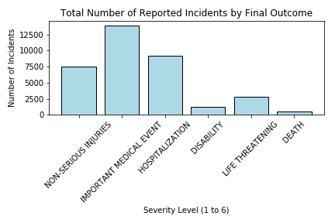
Hypothesis: For individuals who take vitamins and have an adverse reaction, the outcome will be non-serious
One-sample t.test
p-value < 0.05
Reject null hypothesis

Slide 8
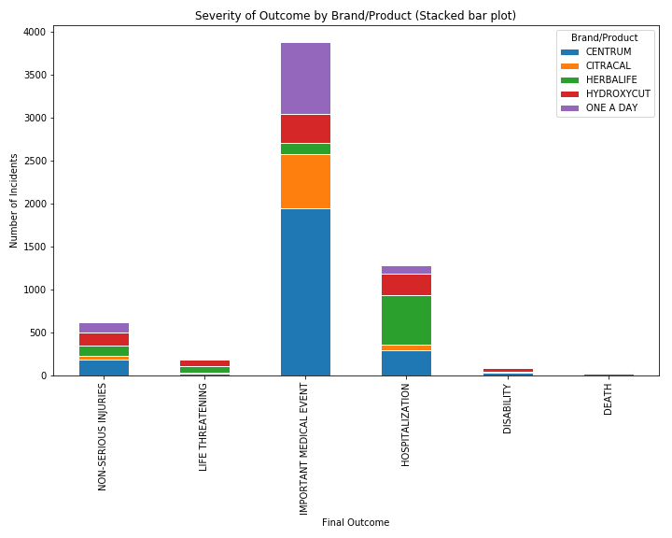
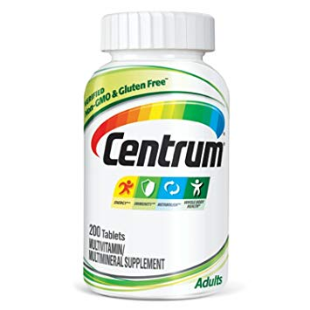
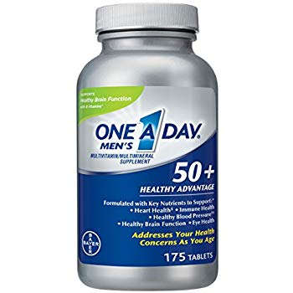
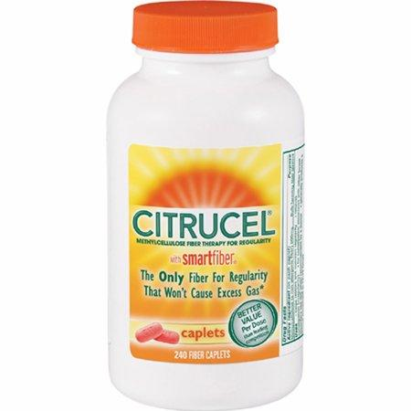
Of reported incidents, Important Medical Event is the predominant outcome with Centrium, One A Day, and Citrucel as the top brand/products

Slide 9
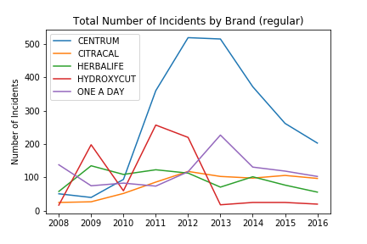
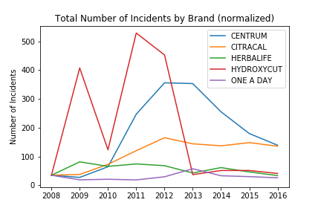
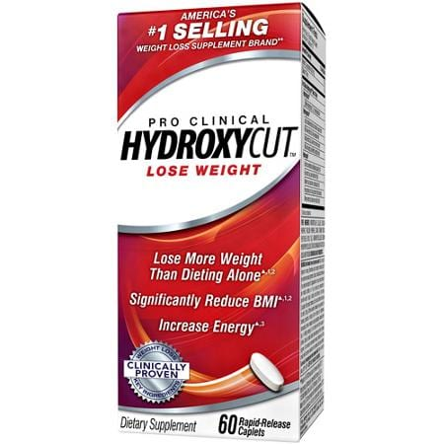
Why the drop for Hydroxycut in 2010 and 2012?
In 2009, FDA issued a recall of Hydroxycut products due to liver injuries, and the company faced a class action lawsuit (CBS News)
In Nov 2012, $25.3 million Hydroxycut settlement was reached for affected US consumers
Afterwards, Hydroxycut was reformulated and placed back on sale

Slide 10
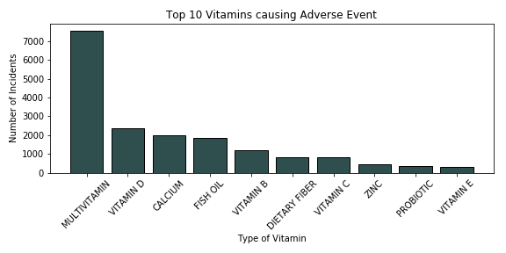
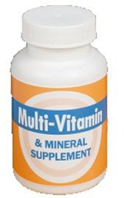
Multivitamin is the top vitamin type reported with an adverse event

Slide 11
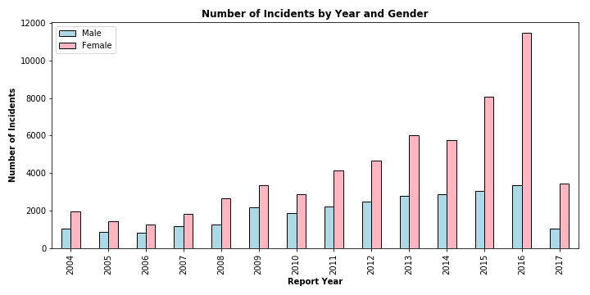
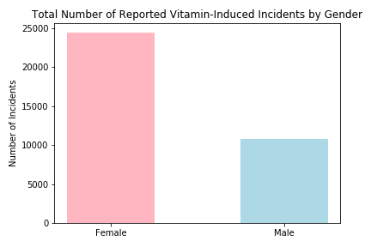
Women have higher number of reported incidents than men

Slide 12
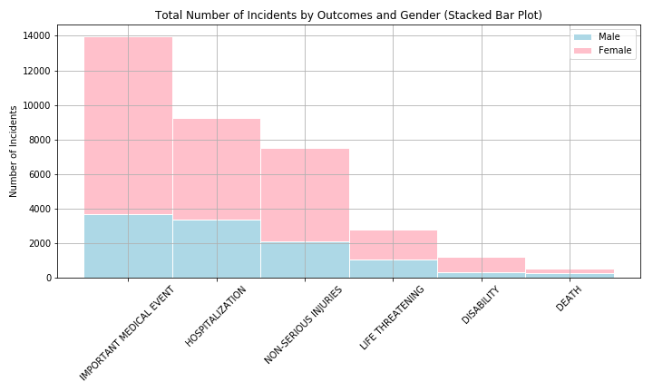
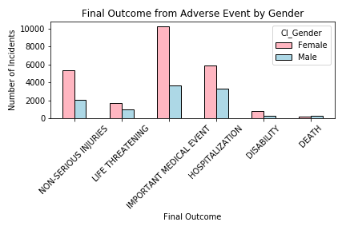
Outcomes of women are significantly different than that of men
Two-sample t-test
p-value < 0.05, reject null hypothesis

Slide 13
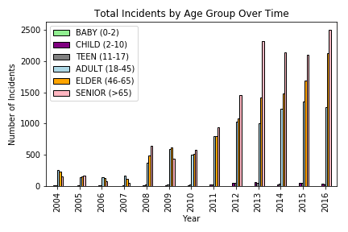
Since 2011, reported incidents are increasing for older individuals
By brand/product (Dinesh)

Slide 14
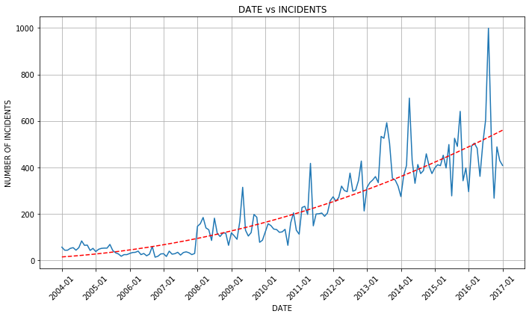
Forecasting: Increasing number of incidents over time

Slide 15
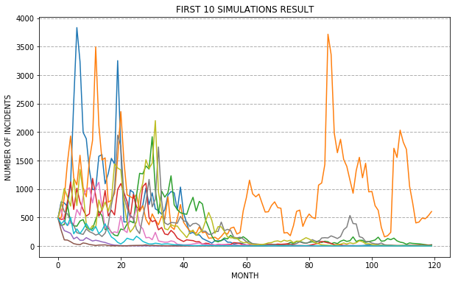
Simulations

Slide 16
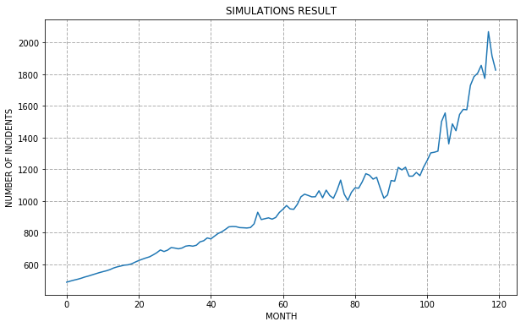

Simulations

Slide 17
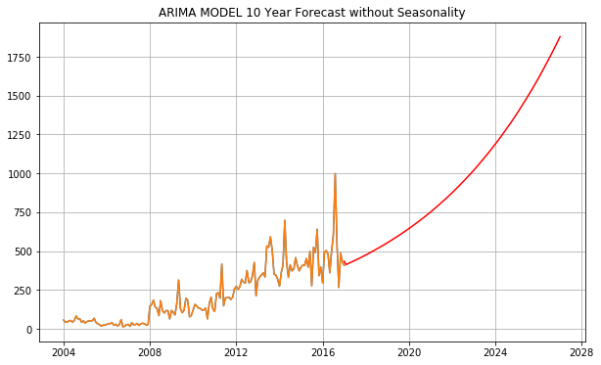
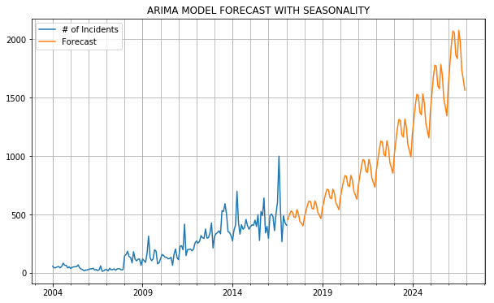
10 year forecasting model shows gradual increase in incidents

Slide 18
Analysis
Multivitamin is the top vitamin type reported with an adverse event
Since 2004, women have higher reported incidents than men
Important medical event is the predominant outcome reported, suggesting that the outcome tend to be serious
Centrium, One A Day, and Citrucel are the top brands reported with adverse event
Since 2011, reported incidents are increasing for older individuals
Forecasting & Simulation models suggest a steady increase of reported incidents in the next 10 years
Based on our results, we highly recommend for the FDA to inform the public about the increase in reported vitamin-induced incidents among individuals, especially women and older persons, and that the outcome appear to be fairly serious.

Slide 19
Thank you for your attention!
Questions?

